Slide 1
Sequential Circuits

Slide 2
ياداوري
آموزش تکنيک هاي طراحي و پياده سازي سيستم هاي پيچيده:
سيستم:
داراي ورودي ها، خروجي ها و رفتار مشخصي است
اين رفتار توسط فانکشن هايي تعيين مي شود که ورودي ها را به خروجي ها تبديل (نگاشت) مي کند.
مثال: گوشي تلفن:
ورودي ها: کليدها
خروجي ها: صفحة نمايش و سيگنال هاي ارسالي به مرکز تلفن
رفتار: شماره گيري و ايجاد ارتباط
مثال: خودرو:
ورودي ها: پدال ها، سوييچ، فرمان، ...
خروجي ها: فرمان پيچش و چرخش چرخ ها، فرمان ترمز، ...
رفتار: ....
مثال: تلويزيون:

Slide 3
Sequential vs. Combinational
Combinational Logic:
Output depends only on current input
Sequential Logic:
Output depends not only on current input but also on current state of the system (which depends on past input values)
inputs
system
outputs

Slide 4
Sequential vs. Combinational
Combinational Logic:
Output depends only on current input
TV channel selector (0-9)
Sequential Logic:
Output depends not only on current input but also on current state of the system (which depends on past input values)
TV channel selector (up-down)
Need some type of memory to remember the current state
inputs
system
outputs

Slide 5
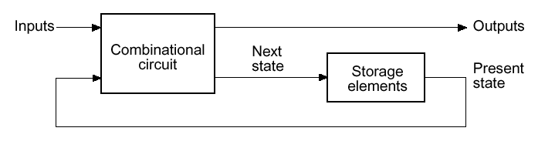
Sequential Logic
Sequential Logic circuits
Remembers past circuit state.
Outputs from the system are “fed back” as new inputs.
Storage elements:
Circuits that are capable of storing binary information
Memory

Slide 6
Feedback Loop
Feedback:
A signal s1 depends on another signal whose value depends on s1
(perhaps with several intermediate signals).
s1
R
Q
Q’
S

Slide 7
Base of Memory
Consider the following circuit:
It can differentiate between two different states
because it has only one feedback line that can keep one of two values, 0 or 1.
P1 = P2 = 0
either 0 or 1

Slide 8
Base of Memory
Consider the following circuit:
It can differentiate between two different states because it has only one feedback line that can keep one of two values, 0 or 1.
A circuit with n feedback lines has 2^{n} potential states, and that the memory of our circuit depends on the number of its feedback lines:
P1 = P2 = 0
0
1

Slide 9
SR latch (NOR version)
S
R
S
R
Q
0
0
hold
0
1
0
1
0
1
1
1
Not allowed
R
Q
S
Q’

Slide 10
SR latch (NOR version)
S
R
S
R
Q
0
0
hold
0
1
0
Truth Table:
Next State = F(S, R, Current State)
1
0
1
1
1
Not allowed
S(t) R(t) Q(t) Q(t+)
0 0 0 0 (hold)
0 0 1 1 (Hold)
0 1 0 0 (reset)
0 1 1 0 (reset)
1 0 0 1 (set)
1 0 1 1 (set)
1 1 0 Not allowed
1 1 1 Not allowed
R
Q
S
Q’

Slide 11
SR Latch
Truth Table:
Next State = F(S, R, Current State)
Derived K-Map:
S(t) R(t) Q(t) Q(t+)
0 0 0 0 (hold)
0 0 1 1 (Hold)
0 1 0 0 (reset)
0 1 1 0 (reset)
1 0 0 1 (set)
1 0 1 1 (set)
1 1 0 Not allowed
1 1 1 Not allowed
Characteristic Equation:
Q+ = S + R Q
t

Slide 12
SR Latch
Truth Table:
Next State = F(S, R, Current State)
Derived K-Map:
S(t) R(t) Q(t) Q(t+)
0 0 0 0 (hold)
0 0 1 1 (Hold)
0 1 0 0 (reset)
0 1 1 0 (reset)
1 0 0 1 (set)
1 0 1 1 (set)
1 1 0 Not allowed
1 1 1 Not allowed
Characteristic Equation:
Q+ = S + R Q
t
S
R-S
Latch
Q+
R
Q

Slide 13
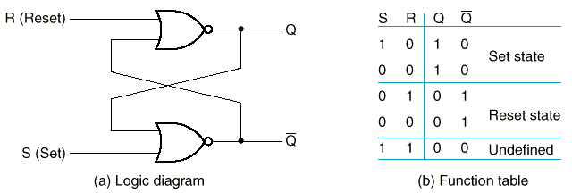
R=S=1 ??
Illegal output, because
When S=R=1, both outputs go to zero.
If both inputs now go to 0, the state of the SR latch depends on delays.
Hence, “undefined” state.
MUST be avoided.

Slide 14
Timing Diagram
Reset
Hold
Set
Reset
Set
100
Race
R
S
Q
Q’
Forbidden
State
Forbidden
State

Slide 15
Timing Diagram
Reset
Hold
Set
Reset
Set
100
Race
R
S
Q
Q’
Forbidden
State
Forbidden
State

Slide 16
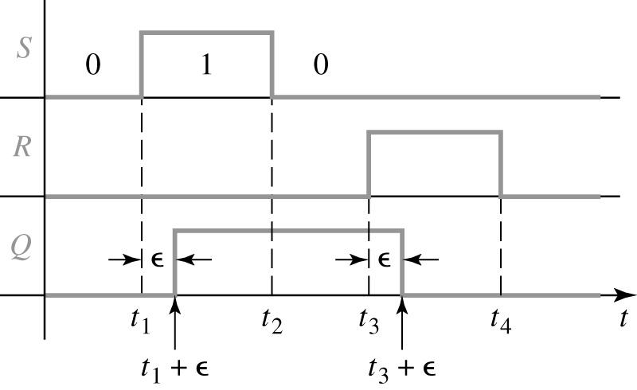
Timing Diagram of SR Latch

Slide 17
SR Latch State Diagram
Observed State Diagram
Q Q
Q Q
0 1
1 0
Q Q
0 0
Difficulty in observing R-S Latch in the 1-1 state
Ambiguously returns to state 0-1 or 1-0

Slide 18
SR Latch State Diagram
Observed State Diagram
Q Q
Q Q
0 1
1 0
Q Q
0 0
Difficulty in observing R-S Latch in the 1-1 state
Ambiguously returns to state 0-1 or 1-0

Slide 19
S’R’ Latch (NAND version)
0
S’
S’ R’ Q Q’
Q
1
0 0
0 1
1 0
1 1
1 0 Set
Q’
0
1
R’
X Y NAND
S
0 0 1
0 1 1
1 0 1
1 1 0
Q
R-S
Latch
R
Q’

Slide 20
S’R’ Latch (NAND version)
1
S’
S’ R’ Q Q’
Q
1
0 0
0 1
1 0
1 1
1 0 Set
Q’
0
1
R’
1 0 Hold
X Y NAND
0 0 1
0 1 1
1 0 1
1 1 0

Slide 21
S’R’ Latch (NAND version)
1
S’
S’ R’ Q Q’
Q
0
0 0
0 1
1 0
1 1
1 0 Set
0 1 Reset
Q’
1
1
R’
1 0 Hold
0 1 Hold
X Y NAND
0 0 1
0 1 1
1 0 1
1 1 0

Slide 22
S’R’ Latch (NAND version)
1
S’
S’ R’ Q Q’
Q
0
0 0
0 1
1 0
1 1
1 0 Set
0 1 Reset
Q’
1
0
R’
1 0 Hold
X Y NAND
0 0 1
0 1 1
1 0 1
1 1 0

Slide 23
S’R’ Latch (NAND version)
0
S’
S’ R’ Q Q’
Q
1
0 0
0 1
1 0
1 1
1 1 Disallowed
1 0 Set
0 1 Reset
Q’
1
0
R’
1 0 Hold
0 1 Hold
X Y NAND
0 0 1
0 1 1
1 0 1
1 1 0

Slide 24
SR Latch with Control (Enable)
S
S’
Q
C
Q’
R
R’
S R C S’ R’ Q Q’
0 0 1 1 1 Q₀ Q₀’ Hold
0 1 1 1 0 0 1 Reset
1 0 1 0 1 1 0 Set
1 1 1 0 0 1 1 Disallowed
X X 0 1 1 Q₀ Q₀’ Hold

Slide 25
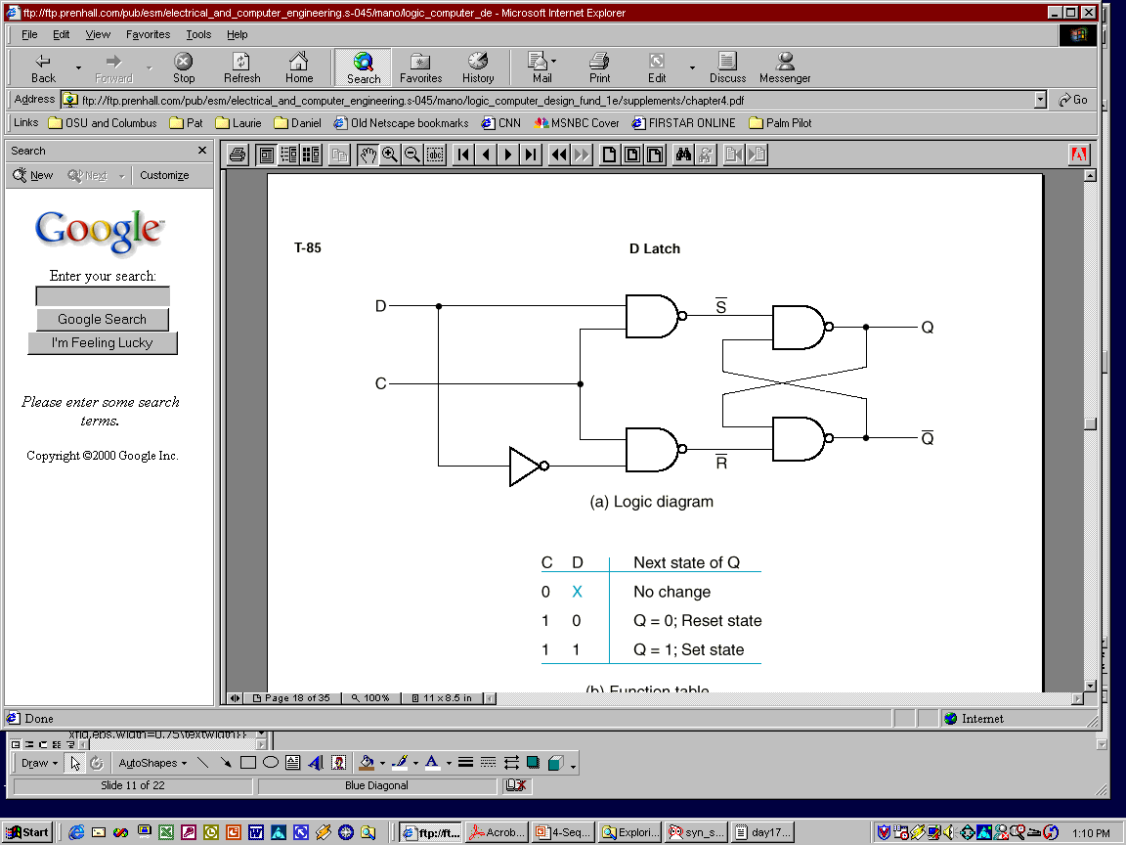
D Latch
S-R latches are useful in control applications,
where we often think in terms of setting a flag in response to some condition, and resetting it when conditions change
We often need latches simply to store bits presented on a signal line
→ D latch
Can eliminate the undesirable indeterminate state in the RS latch:
ensure that inputs S and R are never 1 simultaneously.
D
Q
D
Latch
Q’
C

Slide 26
D Latch
S-R latches are useful in control applications,
where we often think in terms of setting a flag in response to some condition, and resetting it when conditions change
We often need latches simply to store bits presented on a signal line
→ D latch
Can eliminate the undesirable indeterminate state in the RS flip flop:
ensure that inputs S and R are never 1 simultaneously.
D
Q
D
Latch
Q’
C

Slide 27
D Latch (cont.)
S
S’
Q
C
Q’
R
R’
S R C Q Q’
0 0 1 Q₀ Q₀’ Store
0 1 1 0 1 Reset
1 0 1 1 0 Set
1 1 1 1 1 Disallowed
X X 0 Q₀ Q₀’ Store

Slide 28
D Latch (cont.)
S
D
S’
Q
C
Q’
R
R’
S R C Q Q’
D C Q Q’
0 0 1 Q₀ Q₀’ Store
0 1 1 0 1 Reset
1 0 1 1 0 Set
1 1 1 1 1 Disallowed
X X 0 Q₀ Q₀’ Store
0 1 0 1
1 1 1 0
X 0 Q₀ Q₀’

Slide 29
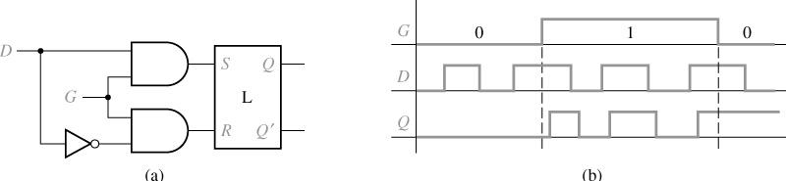
D Latch Timing Diagram
D
Q
D
Latch
Q’
C
C

Slide 30
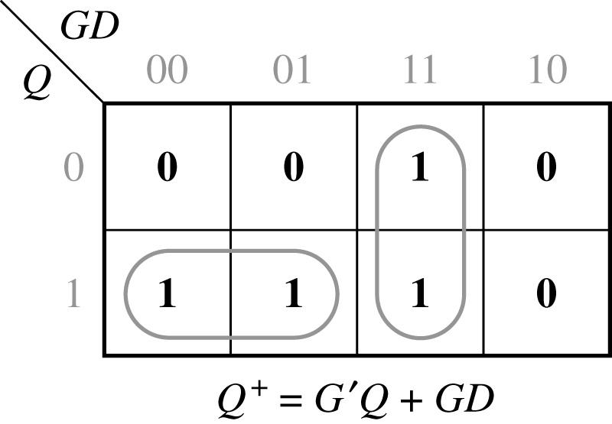
D-Latch Circuit
D
Q
D
Latch
Q’
C
C D Q | Q+
0 0 0 0 0 1 0 1 0 0 1 1 1 0 0 1 0 1 1 1 0 1 1 1 | 0 1 0 1 0 0 1 1
C D
Q+ = C’.Q + C.D

Slide 31
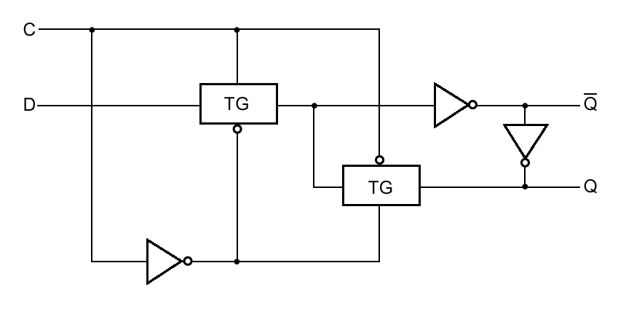
D Latch with Transmission Gates
1
2
C=1 → TG1 closes and TG2 opens → Q’=D’ and Q=D
C=0 → TG1 opens and TG2 closes → Hold Q and Q’

Slide 32
آزمون
مراعات قوانين امتحان
با تخلف برخورد می شود
جواب هر سؤال در جای خودش
بقيه پاسخ ها تصحيح نمی شوند
فقط جواب های سامانه
ايميل و غيره پذيرفته نخواهد شد
سؤال در BBB در گفتگوی خصوصی

Slide 33
JK Latch
J
Q
J(t) K(t) Q(t) Q(t+)
0 0 0 0
0 0 1 1
0 1 0 0
0 1 1 0
1 0 0 1
1 0 1 1
1 1 0 1
1 1 1 0
(hold)
(hold)
(reset)
(reset)
(set)
(set)
(toggle)
(toggle)
K
Q’
J-K Latch
J, K both one yields toggle

Slide 34
JK Latch
J
Q
J(t) K(t) Q(t) Q(t+)
0 0 0 0
0 0 1 1
0 1 0 0
0 1 1 0
1 0 0 1
1 0 1 1
1 1 0 1
1 1 1 0
(hold)
(hold)
(reset)
(reset)
(set)
(set)
(toggle)
(toggle)
K
Q’
J-K Latch
Derived K-Map:
JK
J
Q
00
01
11
10
J, K both one yields toggle
(
t
)
0
0
0
1
1
1
1
0
0
1
K
Characteristic Equation:
Q+ = Q K’ + Q’ J

Slide 35
JK Latch Using SR Latch
How to eliminate the forbidden state in SR?
Idea: use output feedback to
guarantee that R and S are
never both one
J, K both one yields toggle
S
Q
Q
J
R-S
latch
K
R
Q’
Q’
J(t) | K(t) | Q(t) | Q(t+Δ)
0 0 | 0 0 | 0 1 | 0 HOLD 1
0 0 | 1 1 | 0 1 | 0 RESET 0
1 1 | 0 0 | 0 1 | 1 SET 1
1 1 | 1 1 | 0 1 | 1 TOGGLE 0
Characteristic Equation:
Q+ = Q K + Q J

Slide 36
JK Latch Race Condition
Set
Reset
Toggle
Toggle Correctness: Single State changes
Solution: Master/Slave Flipflop

Slide 37
JK Latch Race Condition
Set
Reset
Toggle
Toggle Correctness: Single State changes
Solution: Master/Slave Flipflop

Slide 38
Flip-Flops
Latches are “transparent” (= any change on the inputs is seen at the outputs immediately).
This causes synchronization problems!
Solution: use latches to create flip-flops that can respond (update) ONLY at SPECIFIC times (instead of ANY time).

Slide 39
Alternatives in FF choice
Types of FF
RS
D
JK
T

Slide 40
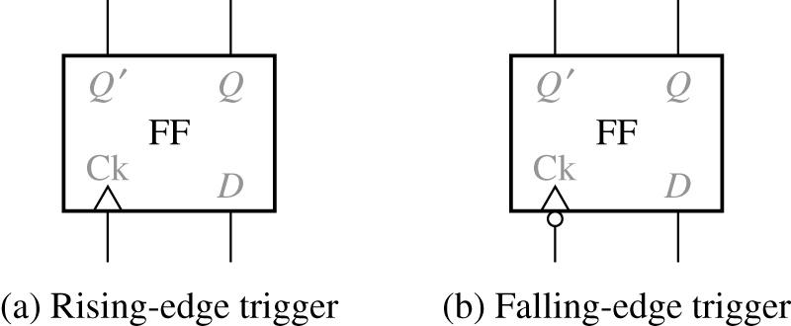
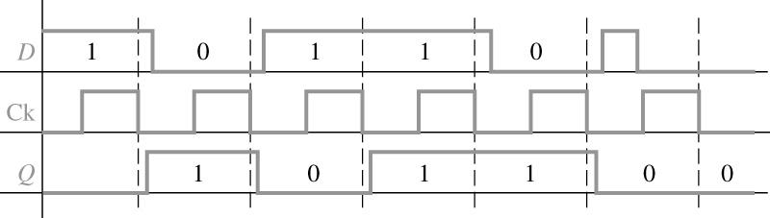
D-FF
0 0 0 1 1 0 1 1 | 0 0 1 1
Truth table
Timing for D Flip-Flop (Falling-Edge Trigger)

Slide 41
D-FF
0 0 0 1 1 0 1 1 | 0 0 1 1
Truth table
Timing for D Flip-Flop (Falling-Edge Trigger)

Slide 42
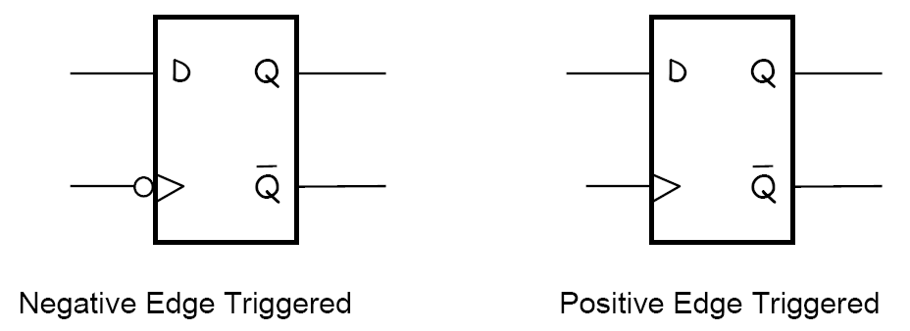
Symbols

Slide 43
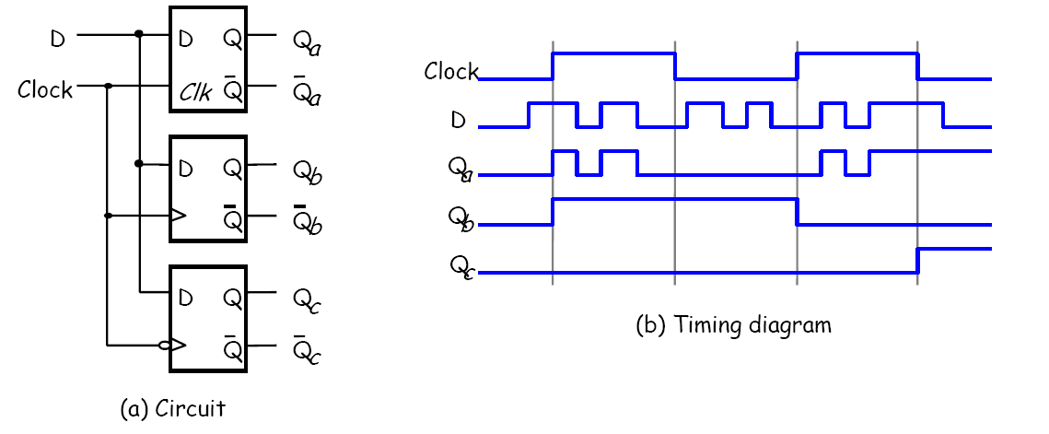
Compare 3 Types

Slide 44
Compare 3 Types

Slide 45
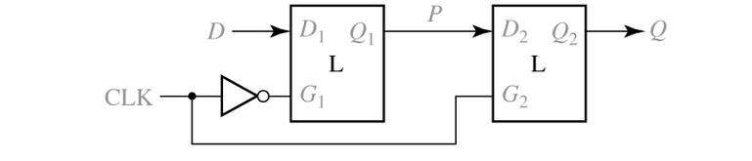
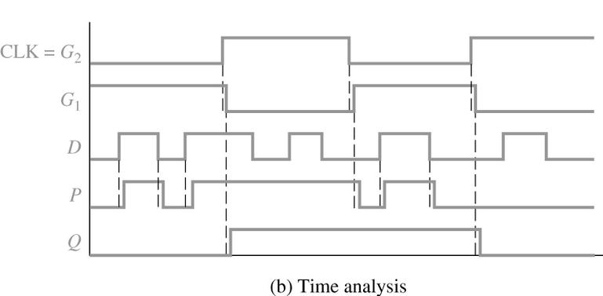
Rising Edge D-FF

Slide 46
Rising Edge D-FF
What About Falling-Edge Circuit?

Slide 47
Setup & Hold Time and Propagation Delay
Setup time:
D input must be stable for a certain amount of time before the active edge of clock cycle
Hold time:
D input must be stable for a certain amount of time after the active edge of the clock
Propagation Delay (Clock-to-Output):
from the time the clock changes to the time the output changes
Propagation Delay (Data-to-Output):
from the time the data changes to the time the output changes

Slide 48
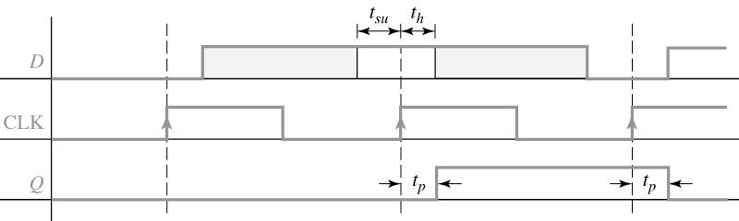
Setup & Hold Time and Propagation Delay
Setup and Hold Times for an Edge-Triggered D Flip-Flop
t_{pLH} may be different from t_{pHL}
t_{p} clock-to-output vs. t_{p} D-to-output

Slide 49
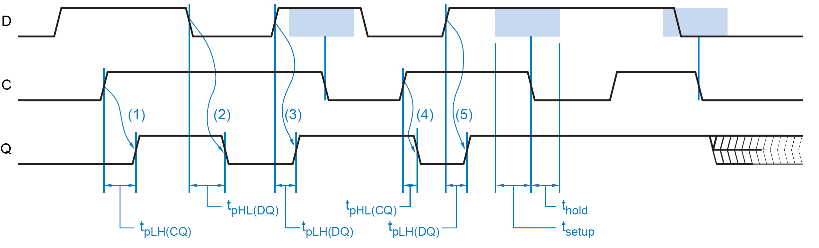
Timing Parameters of a D-Latch

Slide 50
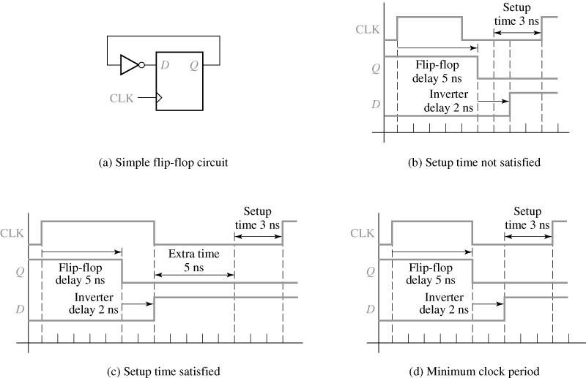
Edge-Triggered D Flip-Flop
Determination of Minimum Clock Period
Assume:
t_{co}= 5 ns
t_{p,inv} = 2 ns
t_{su}= 3 ns

Slide 51
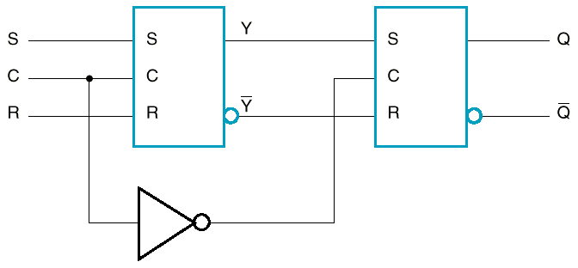
Master-Slave FF Configuration Using SR Latches
Enables edge-triggered behavior

Slide 52
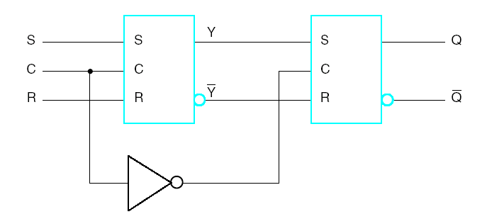
Master-Slave FF configuration using SR latches (cont.)
S R CLK Q Q’
When C=1, master is enabled and stores new data, slave stores old data.
When C=0, master’s state passes to enabled slave (Q=Y), master not sensitive to new data (disabled).
0 0 1 Q₀ Q₀’ Store
0 1 1 0 1 Reset
1 0 1 1 0 Set
1 1 1 1 1 Disallowed
X X 0 Q₀ Q₀’ Store
Master
Slave

Slide 53
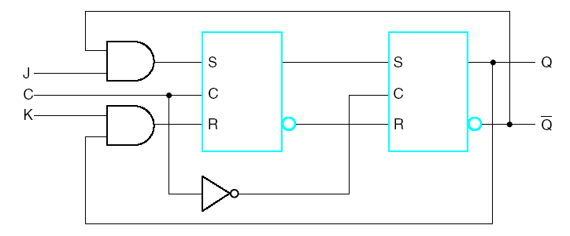
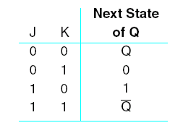
Master-Slave J-K Flip-Flop

Slide 54
Master-Slave J-K Flip-Flop
P
P’
Sample inputs while clock high
Sample inputs while clock low
1's
Set
Reset
Catch
T
oggle
100
J
K
C
Correct Toggle
Operation
P
Master
P‘
outputs
‘
Q
Slave
Q’
outputs

Slide 55
Edge-Triggered FF
Negative Edge-Triggered
D flipflop
4-5 gate delays
setup, hold times
necessary to successfully
latch the input

Slide 56
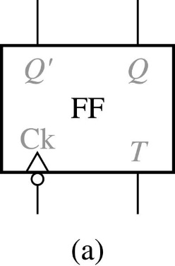
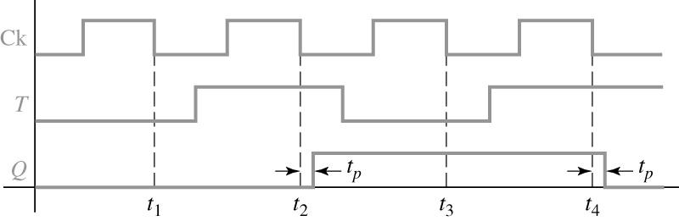
T Flip-Flop
T Flip-Flop
0 0 0 1 1 0 1 1 | 0 1 1 0
Timing Diagram for T Flip-Flop (Falling-Edge Trigger)

Slide 57
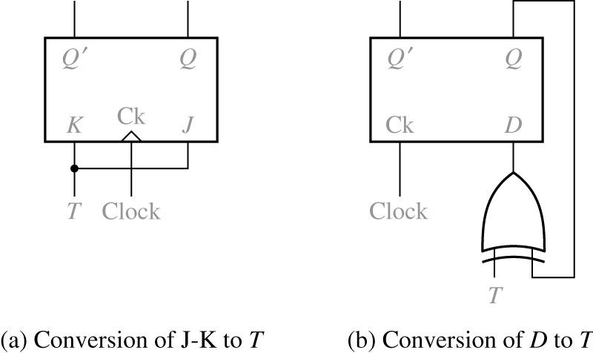
Implementation of T-FF
Implementation of T Flip-Flop

Slide 58
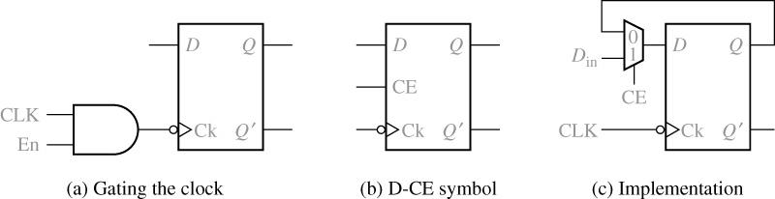
FFs with Additional Inputs
D Flip-Flop with Clock Enable
The characteristic equation :
The MUX output :

Slide 59
Asynchronous Preset/Clear
Many times it is desirable to asynchronously (i.e., independent of the clock) set or reset FFs.
Example: At power-up, we can start from a known state.
Asynchronous set == direct set == Preset
Asynchronous reset == direct reset == Clear
There may be “synchronous” preset and clear.
S
D
Q
C
Q’
R

Slide 60
Asynchronous Set/Reset
Cn indicates that Cn controls all other inputs whose label starts with n.
In this case, C1 controls 1J and 1K.
S
1J
Function Table
C1
S | R | C1 | 1J | 1K | Q(t+1)
0 | 1 | X | X | X | 1 – Preset
1 | 0 | X | X | X | 0 – Clear
0 | 0 | X | X | X | Undefined
1 | 1 | ↑ | 0 | 0 | Q(t) – Hold
1 | 1 | ↑ | 0 | 1 | 0 – Reset
1 | 1 | ↑ | 1 | 0 | 1 – Set
1 | 1 | ↑ | 1 | 1 | Q(t)’ -- Complement
1K
R
IEEE standard graphical symbol for JK-FF with direct set & reset

Slide 61
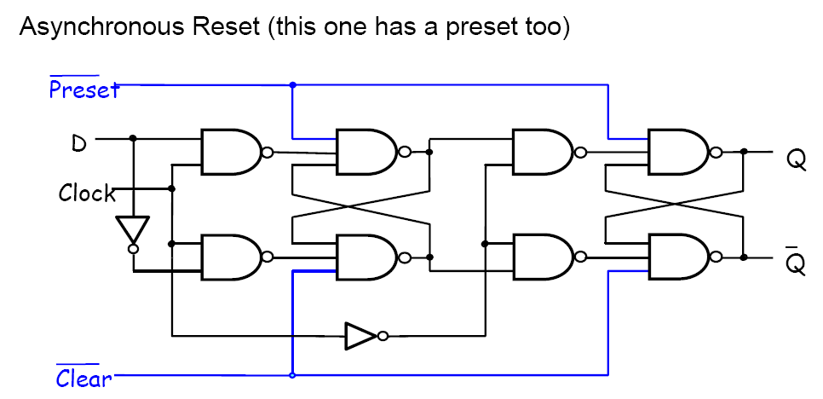
Asynchronous Inputs

Slide 62
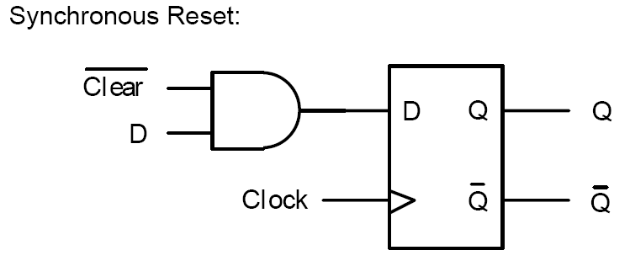
Synchronous Reset

